Slide 1

Artificial Intelligence Readiness Scale
Extending UTAUT2 for Enterprise AI Adoption
Fabio Correa | Doctor of Business Administration
Touro University Worldwide | December 2025

Slide 2
Dissertation Committee
Dr. Karina Kasztelnik
Dr. Jerome Jones
Dr. Donna Day
Committee Chair
Committee Member
Committee Member
Thank you for the opportunity to present this research on developing a diagnostic instrument to understand AI adoption readiness in organizational contexts.

Slide 3
Research Overview
The Study
Presentation Agenda
This dissertation presents the development and validation of the Artificial Intelligence Readiness Scale (AIRS-16), a psychometric instrument extending UTAUT2 to measure AI adoption readiness.
The AI adoption paradox and research gaps
Theoretical framework and hypotheses
Methodology and sample characteristics
Key findings and paradigm shifts
Primary Goal: Help organizations understand why individuals adopt or resist AI tools by providing validated diagnostic measurement.
Theoretical and practical contributions
Limitations and future directions

Slide 4

The AI Adoption Paradox
88%
6%
90-95%
Organizations Report AI Adoption
Achieve Meaningful Business Value
AI Pilots Fail to Scale
MIT Media Lab findings
McKinsey State of AI 2025
Despite significant investment
The Critical Gap: Organizations invest heavily in AI technology but lack validated tools to understand why individuals actually adopt or resist these systems at the human level.

Slide 5
Three Interconnected Research Gaps
01
02
03
Theoretical Gap
Measurement Gap
Practice Gap
UTAUT2 was validated on mobile apps and consumer technologies, not AI systems. Venkatesh (2021) identified nine unique AI adoption challenges that existing frameworks fail to address, including trust in opaque systems, ethical concerns, and autonomous decision-making.
No psychometrically validated instrument exists to measure AI adoption readiness. Organizations rely on ad hoc surveys, general technology readiness scales, or anecdotal feedback—none designed specifically for AI contexts.
Without valid diagnostic measurement, organizations cannot identify adoption barriers, segment users effectively, or design targeted interventions. This contributes directly to the 90-95% pilot failure rate.

Slide 6
Research Questions
Primary Research Question
How can UTAUT2 be extended with AI-specific constructs to better predict behavioral intention to adopt AI tools in professional and academic contexts?
Secondary Research Questions
RQ
Focus
Answer
RQ1
Factor structure
8 factors with 16 validated items
RQ2
Measurement invariance
Configural invariance achieved across populations
RQ3
Strongest predictors
Price Value > Hedonic Motivation > Social Influence
RQ4
AI Trust extension
Marginal effect (p = .064) with diagnostic value
RQ5
Moderators
Experience and population moderate hedonic motivation

Slide 7
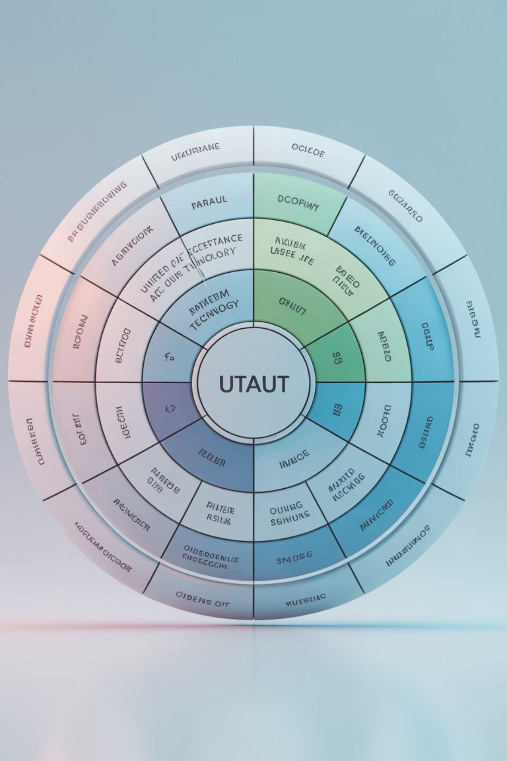
Theoretical Framework: UTAUT2
Why UTAUT2?
AI-Specific Extension
Superior explanatory power: 74% variance vs. TAM's ~40%
AI Trust added as theoretically grounded extension based on Glikson & Woolley (2020).
Theoretical integration: Synthesizes 8 prior models (TRA, TPB, TAM, MM, etc.)
Trust in AI differs fundamentally from general technology trust due to AI's opacity, probabilistic reasoning, and autonomous decision-making capabilities.
Consumer-relevant constructs: Includes Hedonic Motivation, Price Value, Habit
Current gold standard: Most comprehensive technology acceptance framework

Slide 8







Core UTAUT2 Hypotheses
H1a: Performance Expectancy → BI
AI will improve my work performance
H1b: Effort Expectancy → BI
AI is easy to use and learn
H1c: Social Influence → BI
Important others think I should use AI
H1d: Facilitating Conditions → BI
Resources and support are available
H1e: Hedonic Motivation → BI
Using AI is enjoyable and engaging
H1f: Price Value → BI
Benefits outweigh total costs
H1g: Habit → BI
AI use has become automatic

Slide 9
Novel Hypotheses: Extension & Moderation
H2: AI Trust Extension
H3: Experience Moderation
H4: Population Moderation
AI Trust positively influences Behavioral Intention beyond what UTAUT2 constructs explain.
Experience level moderates the relationships between UTAUT2 constructs and Behavioral Intention.
Population type (students vs. professionals) moderates UTAUT2-BI relationships.
Tests theoretical contribution of AI-specific construct
Tests boundary conditions across expertise
Tests generalizability across contexts

Slide 10

Research Design & Methodology
Study Characteristics
Design
Cross-sectional, quantitative
Sample Size
N = 523 (students + professionals)
Initial Items
28 items across 12 constructs
Final Instrument
16 items across 8 factors
Analysis
EFA → CFA → SEM
Rigorous psychometric validation following established best practices for instrument development and scale validation.

Slide 11


Psychometric Validation Results
Model Fit Indices: Excellent
.975
.960
.065
CFI
TLI
RMSEA
Comparative Fit Index
(Threshold: > .95)
Tucker-Lewis Index
(Threshold: > .95)
Root Mean Square Error
(Threshold: < .08)
Reliability Coefficients
All Cronbach's alpha values exceed .74, well above the .70 threshold for acceptable internal consistency. The instrument demonstrates strong psychometric properties across all validated factors.

Slide 12
Sample Demographics
Participant Characteristics (N = 523)
Quality Controls
Population: 41% Academic contexts, 59% Working professionals
Recruitment: Centiment professional research panel with blinded recruitment methodology.
Education: 34% Some college, 28% Bachelor's, 18% Master's degrees
Experience: 37% with 11+ years, 19% less than 1 year, 18% 1–3 years
Topic not disclosed until consent phase to reduce self-selection bias.
Leadership: 24% in supervisory roles (managers and executives)
Disability: 13% identify as having a disability
Multiple attention checks embedded throughout survey with quality control exclusions applied.

Slide 13

Key Finding #1: The Value Paradigm Shift
What Actually Drives AI Adoption?
Predictor
β
p
Result
Price Value
.505
<.001
✓ Strongest Driver
Hedonic Motivation
.217
.014
✓ Supported
Social Influence
.136
.024
✓ Supported
AI Trust
.106
.064
○ Marginal
Performance Expectancy
−.028
.791
✗ Not Significant
Effort Expectancy
−.008
.875
✗ Not Significant
Facilitating Conditions
.059
.338
✗ Not Significant
Habit
.023
.631
✗ Not Significant
Model R² = .852 — The model explains 85.2% of variance in AI adoption intention, demonstrating exceptional predictive power.

Slide 14

Key Finding #2: Traditional Drivers Fail
A Fundamental Paradigm Shift
Traditional Technology Adoption
AI Adoption Reality
Users ask: "Is this worth my total investment?"
Users ask: "Will this make me productive?"
Organizations must demonstrate value
Organizations respond with feature lists
Price Value dominates (β = .505)
Performance Expectancy dominates
Trust must be established first
Features matter less than worth
Training solves adoption problems
Ease of use is critical
Performance Expectancy, Effort Expectancy, Facilitating Conditions, and Habit—the pillars of 30 years of technology adoption research—are not significant predictors for AI.

Slide 15




Key Finding #3: Four User Segments
Distinct AI Adoption Profiles
AI Enthusiasts (16%)
Cautious Adopters (30%)
Moderate Users (37%)
Anxious Avoiders (17%)
Trust: +1.37σ | Anxiety: −0.86σ | Intent: +1.32σ
Trust: +0.01σ | Anxiety: +0.42σ | Intent: −0.07σ
Trust: +0.86σ | Anxiety: +0.84σ | Intent: +0.88σ
Trust: −1.49σ | Anxiety: +0.76σ | Intent: −1.53σ
Strategy: Deploy as champions and early evangelists. Give early access to new tools.
Strategy: Reduce friction and leverage social influence. Show peer adoption.
Strategy: Provide proof points, case studies, and ROI evidence. Reduce perceived risk.
Strategy: Trust-building interventions before feature exposure. Address anxiety first.

Slide 16
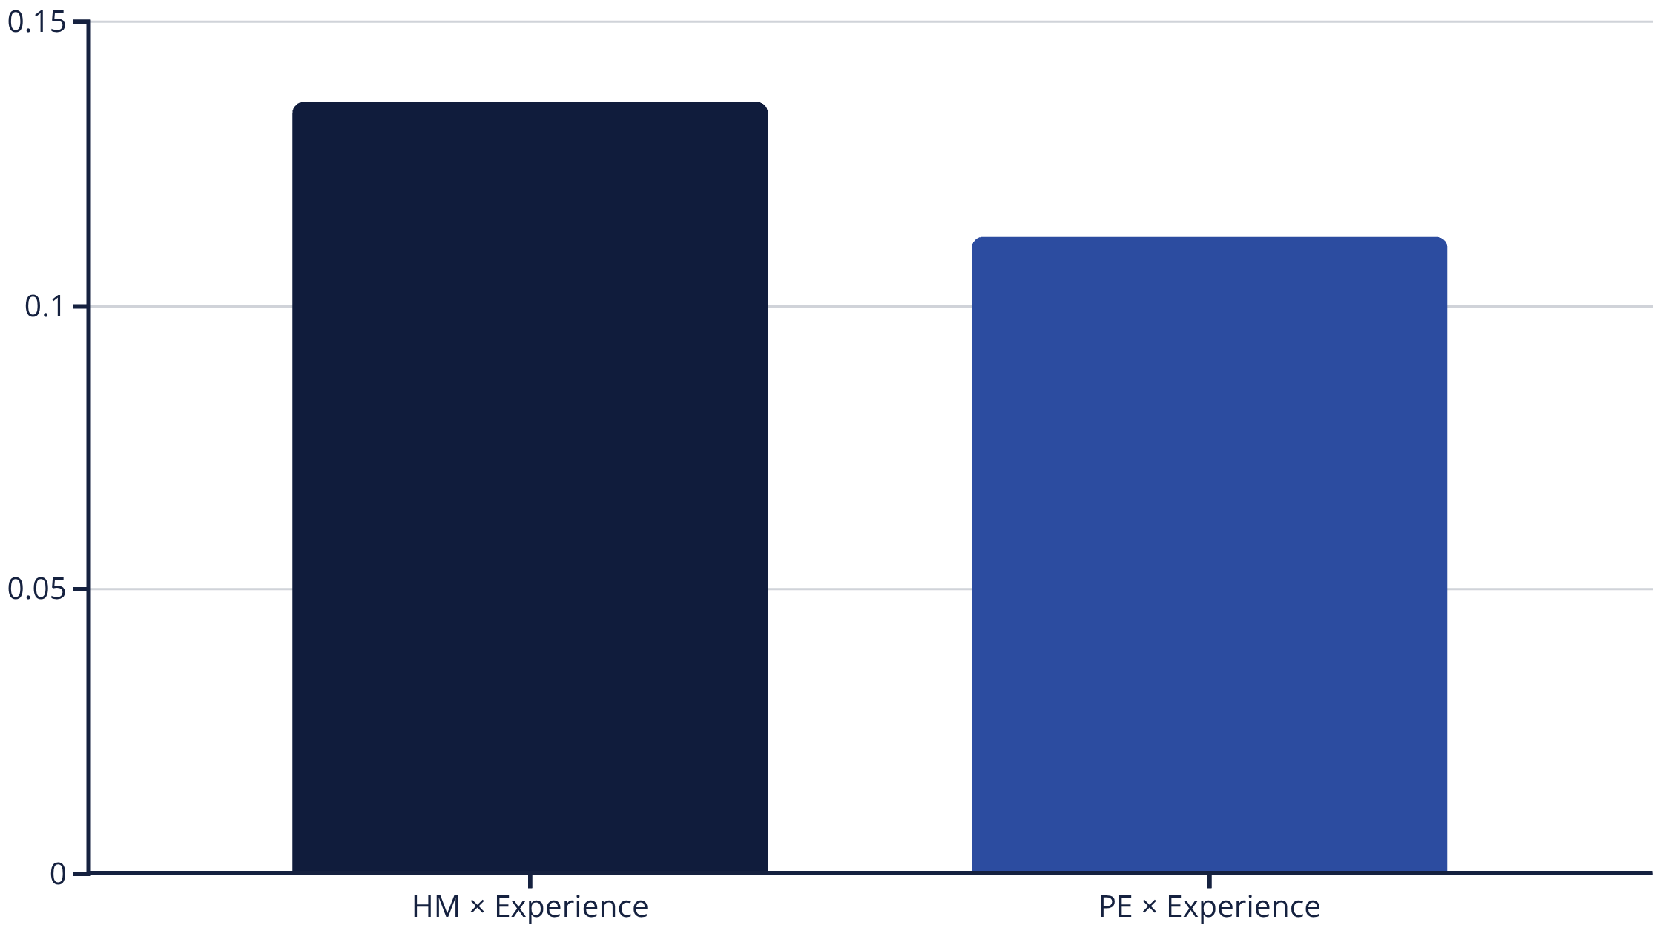
Moderator Finding #1: Experience Effects
Experience Amplifies Hedonic Motivation
Statistical Results
Interpretation
HM × Experience: β = .136, p = .009 (significant)
Experienced professionals (4+ years) weight enjoyment more heavily in adoption decisions, not less. Counterintuitive finding suggests sustainability of use depends on hedonic experience.
PE × Experience: β = .112, p = .055 (marginal)

Slide 17

Moderator Finding #2: Population Differences
Hedonic Motivation: Opposite Effects
Academic Population
HM → BI: β = .449
Strong positive effect. Enjoying tools is valued and culturally acceptable in academic contexts.
Professional Population
HM → BI: β = −.301
Negative effect. Professional norms may view "fun" tools as unprofessional or unserious.
Difference: Δβ = −.750, p = .041 (significant)
Practical Implication: Organizations should message AI tools differently to academic versus professional audiences. "Enjoyable" resonates in academia but may backfire in corporate contexts.

Slide 18
The AIRS-16 Diagnostic Instrument
Validated 8-Factor Measurement Tool
Factor
Items
α
Diagnostic Purpose
Performance Expectancy
2
.80
Perceived productivity benefits
Effort Expectancy
2
.86
Ease of use perceptions
Social Influence
2
.75
Peer and organizational support
Facilitating Conditions
2
.74
Resource and support availability
Hedonic Motivation
2
.86
Enjoyment and engagement
Price Value
2
.88
Worth relative to total cost
Habit
2
.91
Behavioral automaticity
AI Trust
2
.89
AI-specific trust barriers
Administration time: ~3 minutes | Output: Individual diagnostic profile identifying specific adoption barriers for targeted intervention design

Slide 19





Theoretical Contributions
Value-Dominant Model
Traditional Constructs Fail
Price Value (β = .505) dominates Performance Expectancy, reversing 30 years of TAM/UTAUT findings. AI evaluated through cost-benefit lens, not productivity lens.
Performance Expectancy, Effort Expectancy, Facilitating Conditions, and Habit show no predictive power for AI. Challenges core assumptions of technology acceptance theory.
AI Trust as Diagnostic
Measurement Advancement
Marginal predictive effect (p = .064) but essential diagnostic value. Enables targeted trust-building interventions for 17% with trust barriers.
First psychometrically validated AI adoption instrument with demonstrated configural invariance across academic and professional populations.

Slide 20

Practical Contributions
01
Lead with Value, Not Capabilities
Demonstrate ROI before feature lists. Address total investment: financial cost, time, workflow disruption, learning curve, opportunity cost. Answer "Is this worth it?" not "What can it do?"
02
Deploy Segment-Specific Strategies
16% are enthusiasts—leverage them as champions. 30% need proof—provide evidence. 37% will follow—show peer adoption. 17% have trust barriers—address those first.
03
Use Diagnostic Assessment
AIRS-16 takes 3 minutes and identifies specific barriers. Enables targeted resource allocation instead of blanket training programs.
04
Establish Trust as Prerequisite
Nearly 1 in 5 users have trust barriers blocking adoption. Feature demonstrations are ineffective until trust is built. Diagnose who needs trust interventions first.

Slide 21
Study Limitations
Transparency in Research Boundaries
Cross-Sectional Design
Self-Reported Measures
Limitation: Cannot establish causality, only correlation between constructs.
Limitation: Relies on self-reported behavioral intention rather than observed behavior.
Mitigation: Behavioral validation achieved (ρ = .69 with actual usage). Longitudinal research needed for causal inference.
Mitigation: Standard in adoption research. Strong correlation with actual usage validates predictive validity.
Convenience Sample
Geographic Scope
Limitation: Centiment panel sampling, not random population sampling.
Limitation: US-based sample only. Cultural factors may influence adoption drivers.
Mitigation: Diverse demographics achieved. Rigorous quality controls and attention checks applied.
Mitigation: Cross-cultural replication recommended to test measurement invariance globally.

Slide 22
Constructs That Failed Validation
AI-Specific Measurement Challenges
Construct
α
Issue & Future Direction
Voluntariness
.301
Items conceptually conflicted (mandatory vs. choice). Reframe as "perceived pressure" construct.
Explainability
.503
AI explanation is multi-dimensional. Decompose into transparency, interpretability, and auditability.
Ethical Risk
.582
Near threshold. Items conflated personal vs. societal ethics. Separate individual concerns from societal impact.
AI Anxiety
.423
Poor discriminant validity with general tech anxiety. Distinguish AI-specific anxiety from general technology discomfort.
These represent measurement challenges, not theoretical failures. The constructs are theoretically important but require redesigned items and retesting in future research.

Slide 23





Future Research Directions
Longitudinal Validation
Track actual adoption behavior over time to test intention-behavior relationship and model stability. Does high behavioral intention at Time 1 predict adoption at Time 2?
AI-Specific Construct Development
Redesign failed constructs (Explainability, Ethical Risk, Voluntariness, AI Anxiety) with improved measurement. Address Venkatesh's (2021) remaining five AI adoption challenges.
Intervention Effectiveness Testing
Experimental validation of segment-specific strategies. Randomized controlled trials comparing targeted interventions versus generic training programs. Measure ROI of diagnostic assessment.
Cross-Cultural Replication
Test measurement invariance across cultures. Examine whether cultural dimensions (individualism/collectivism) moderate adoption drivers. Does Price Value dominate globally?
Domain-Specific Adaptation
Adapt AIRS-16 for specific contexts: healthcare AI, financial services, educational technology. Compare regulated versus unregulated AI applications.

Slide 24
Summary of Contributions
Theoretical
Methodological
Practical
Value-dominant model challenges three decades of technology acceptance research
AIRS-16: First validated AI adoption readiness instrument
Four distinct user segments with targeted strategies
8-factor structure with excellent psychometrics (CFI = .975)
3-minute diagnostic tool for organizational assessment
AI Trust extends UTAUT2 with diagnostic utility
Demonstrated measurement invariance across populations
Evidence-based recommendations for AI implementation
Evidence that traditional drivers fail for AI adoption
85.2% predictive accuracy
The Bottom Line: Organizations don't have an AI technology problem—they have an AI adoption problem. This research provides the diagnostic tools to understand and address it.

Slide 25
Key Numbers to Remember
523
.505
85.2%
.975
Participants
Price Value β
Variance Explained
CFI
Diverse sample size
Dominant predictor
Model R² accuracy
Excellent model fit
4
16
8
3
User Segments
Items
Factors
Minutes
Distinct typologies
Final instrument
Validated constructs
Assessment time

Slide 26

Thank You
Questions & Discussion
Fabio CorreaDoctor of Business Administration Candidate
Touro University Worldwide
"Organizations don't have an AI technology problem—they have an AI adoption problem. Understanding and diagnosing that adoption problem is the first step to solving it."

Slide 27
Backup: Full Hypothesis Results
Complete Statistical Summary
H
Path
β
p
95% CI
Result
H1a
PE → BI
−.028
.791
[−.234, .178]
✗
H1b
EE → BI
−.008
.875
[−.108, .092]
✗
H1c
SI → BI
.136
.024
[.018, .254]
✓
H1d
FC → BI
.059
.338
[−.062, .180]
✗
H1e
HM → BI
.217
.014
[.044, .390]
✓
H1f
PV → BI
.505
<.001
[.352, .658]
✓
H1g
HB → BI
.023
.631
[−.071, .117]
✗
H2
TR → BI
.106
.064
[−.006, .218]
○
H3
Experience mod
.136
.009
—
✓
H4
Population mod
−.750
.041
—
✓
Note: Confidence intervals that include zero indicate non-significant effects. The three supported UTAUT2 paths (SI, HM, PV) have CIs that exclude zero, confirming significant relationships.

Slide 28
Backup: Model Fit Index Comparison
Detailed Psychometric Assessment
Index
Obtained Value
Excellent Threshold
Acceptable Threshold
CFI (Comparative Fit Index)
.975
≥ .95
≥ .90
TLI (Tucker-Lewis Index)
.960
≥ .95
≥ .90
RMSEA (Root Mean Square Error)
.065
≤ .06
≤ .08
SRMR (Standardized RMR)
.044
≤ .08
≤ .10
The measurement model demonstrates excellent fit across most indices. CFI and TLI exceed the .95 excellent threshold. RMSEA at .065 falls in the acceptable range, slightly above the .06 excellent cutoff—typical for models with this sample size and complexity. SRMR at .044 indicates excellent fit. Overall, the model fits the data very well.

Slide 29



Backup: Understanding Price Value
Beyond Monetary Cost
Price Value measures perceived worth relative to total investment, encompassing multiple cost dimensions:
1
Direct Financial Costs
Software licensing fees, subscription costs, infrastructure investments, implementation expenses
2
Indirect Time Costs
Learning curve duration, training time required, workflow disruption period, productivity dip during transition
3
Hidden Risk Costs
Data privacy concerns, vendor lock-in potential, system dependencies, integration complexity
4
Opportunity Costs
Time spent learning AI instead of performing current productive work, alternative technology options foregone
When evaluating Price Value, users ask: "Is the total value I'll receive worth the total investment I must make?" This is fundamentally different from simply asking "Is this software expensive?"

Slide 30
Backup: Why Four Constructs Failed
Measurement Challenges & Future Directions
Construct
α
What Went Wrong
Future Direction
Voluntariness
.301
Items conceptually conflicted: "Organization requires AI" vs. "I choose voluntarily" interpreted inconsistently
Reframe as unidimensional "perceived pressure" construct rather than bipolar scale
Explainability
.503
AI explanation is multi-dimensional. Items too broad: how model works, why decisions made, auditability are distinct
Decompose into separate factors: transparency, interpretability, auditability with specific items for each
Ethical Risk
.582
Just below threshold. Items conflated personal ethical concerns ("biased decisions about me") with societal impact
Separate individual ethical concerns from broader societal ethical implications
AI Anxiety
.423
Poor discriminant validity: overlapped too much with general technology anxiety and discomfort
Develop items distinguishing AI-specific anxiety from general technology discomfort or resistance
These are not theoretical failures—the constructs remain theoretically important for understanding AI adoption. They represent measurement challenges requiring better item development and psychometric refinement in future research.

